Slide 1

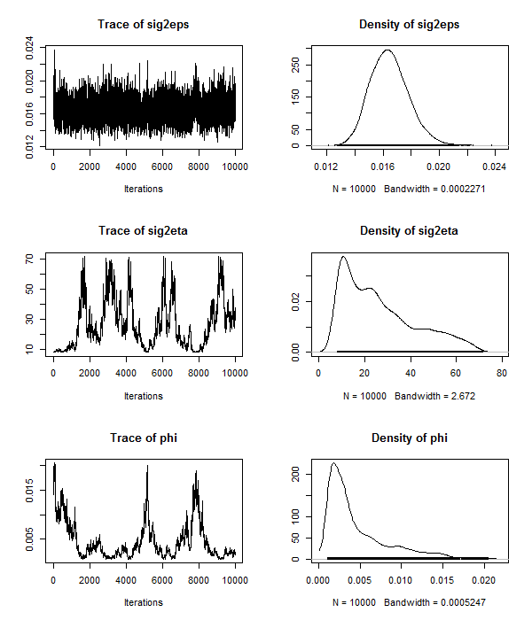
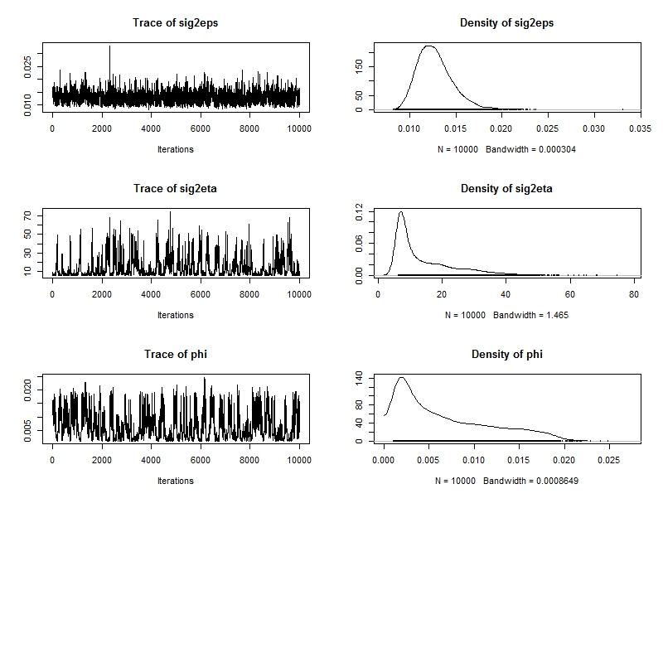
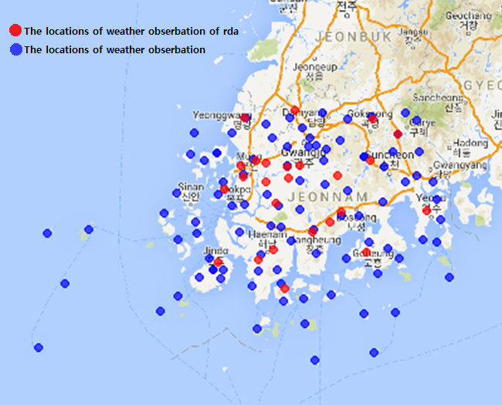
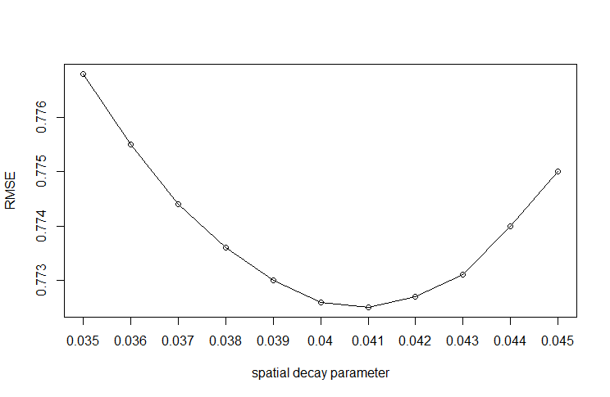
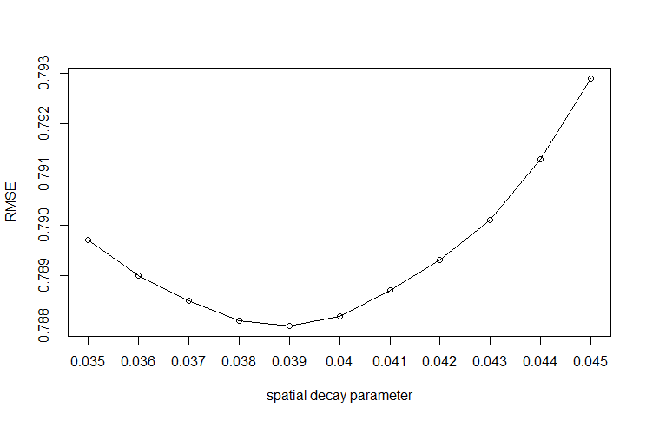
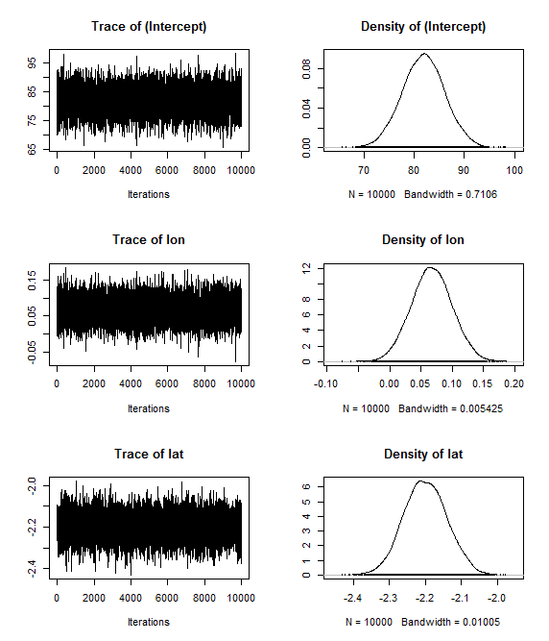
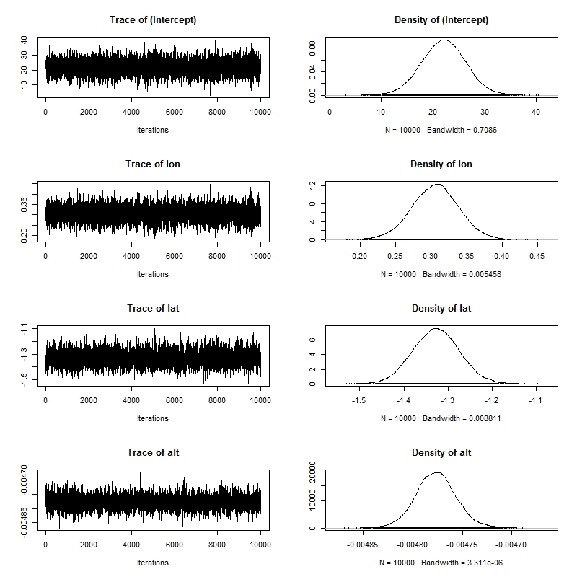
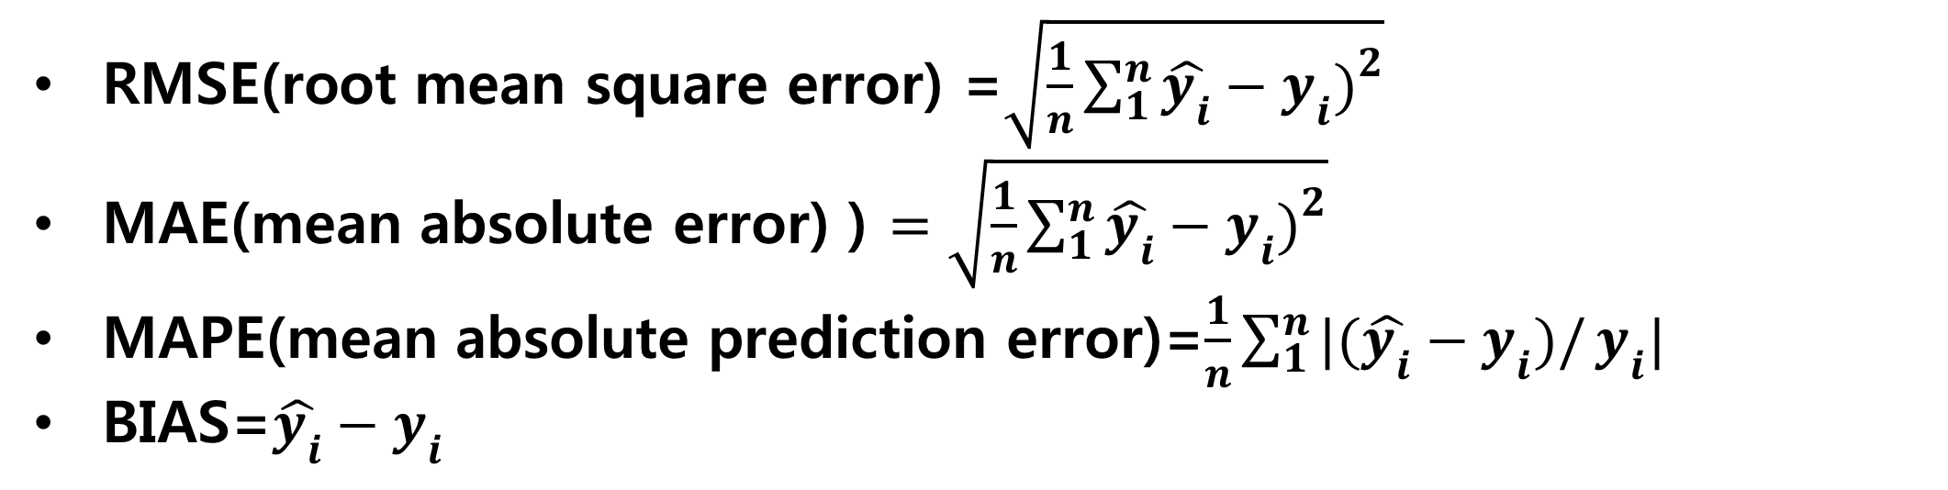

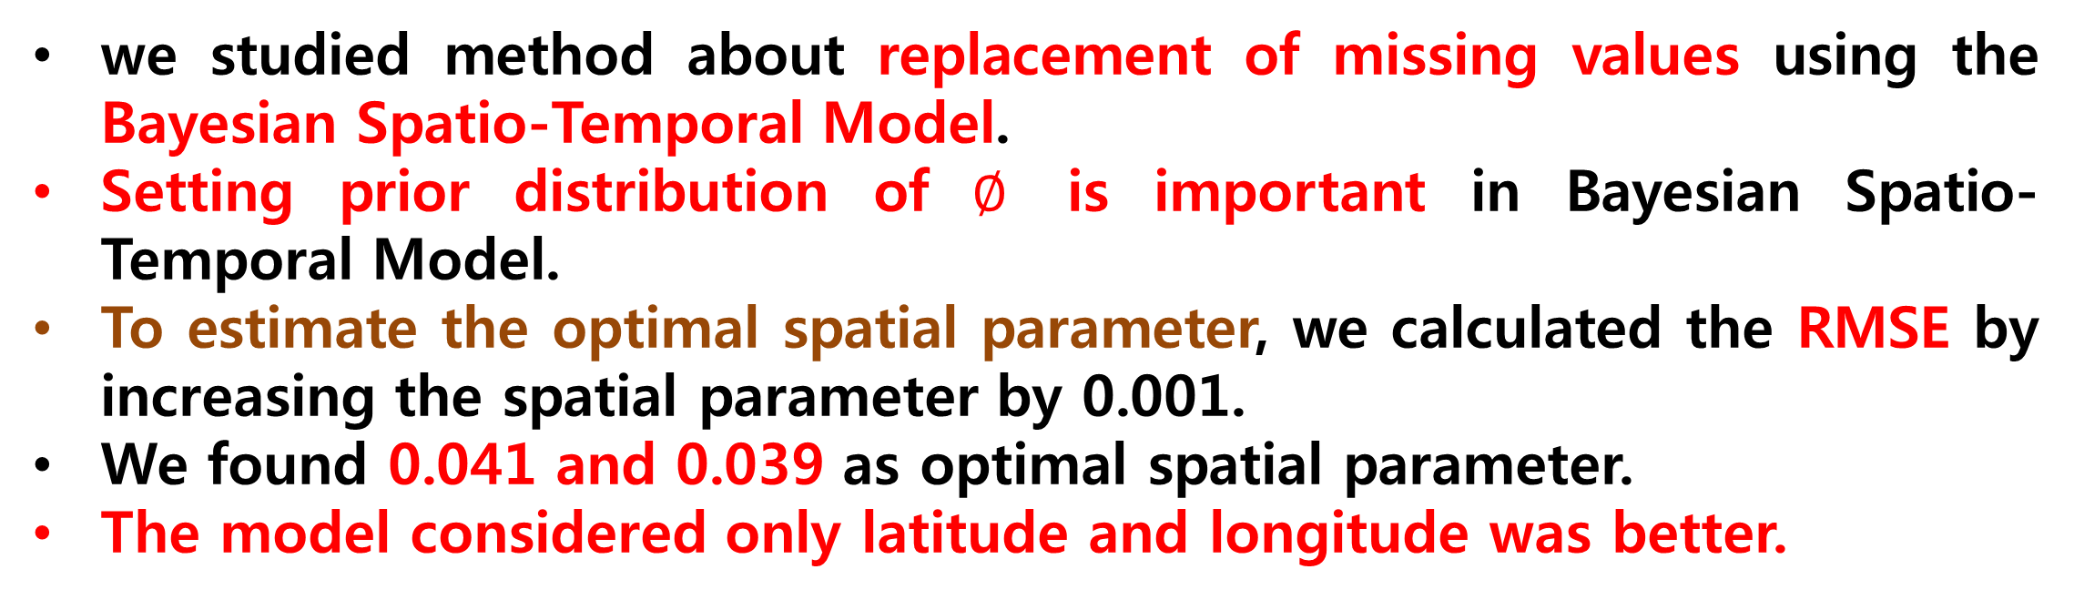



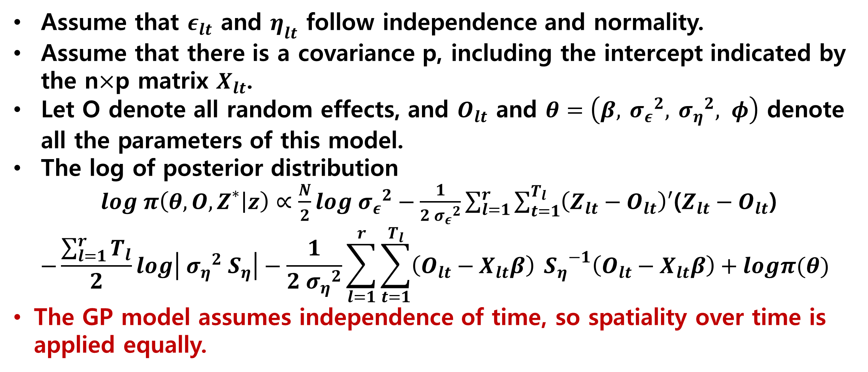
Missing value replacement of agricultural temperature
using Independent Gaussian Process
Dain Park (Master's course, Department of Statistics, Daegu University)
Aeri Kang (Undergraduate Student, Department of Statistics, Daegu University)
Sanghoo Yoon (Assistant professor, Department of Statistics and computer Science, Daegu University)
Purpose
Result
Agricultural meteorological information is important for agricultural profits increase and agricultural disaster prevention. The agricultural meteorological information that provided by Korea Rural Development Administration includes some missing values due to a temporary machine error or communications error.
Meteorological information has spatio-temporal correlation. In this study, we studied method about replacement of missing values of agricultural meteorological information through Bayesian Spatio-Temporal Model.
latitude + longitude
latitude + longitude + altitude
Prior distribution of spatial decay parameter
Prior distribution of spatial decay parameter
Research flow
Independent variable : daily average temperature
Dependent variable : latitude, longitude and altitude
Spatial parameter $∅$is not converge.
Spatial parameter $∅$is not converge.
2013~2016
Agricultural meteorological information
(Korea rural development administration)
2013~2016
meteorological information
(Korea Meteorological Administrarion)
Optima spatial decay
Optima spatial decay
Bayesian Spatio-Temporal Model
Independent Gaussian Process
Model validation
The locations of weather station
RMSE i$s lowest at φ=$ 0.041
RMSE i$s lowest at φ=$ 0.039
Methods for Missing value treatment
Eliminate missing value
Trace plot when optimal ∅
Trace plot when optimal ∅
Substitute to average
Model with Missing value
Bayesian Model
Methodology
Bayesian Spatio-Temporal Model
$Z_{lt}=O_{lt}+ε_{lt}$: True underlying Processes
$O_{lt}=X_{lt}+η_{lt}$: Spatio-temporal random effect :
Independent Gaussian process
Assume that $ε_{lt}$ and $η_{lt}$ follow independence and normality.
Assume that there is a covariance p, including the intercept indicated by the n$×$p matrix $X_{lt}$.
Let O denote all random effects, and $O_{lt}$ and $θ=\left(β, {{ σ}_{ε}}^{2}, {{ σ}_{η}}^{2}, φ\right)$ denote all the parameters of this model.
The log of posterior distribution
$log π\left(θ,O,Z^{∗} | z\right)∝\frac{N}{2}log{{ σ}_{ε}}^{2}−\frac{1}{2{{ σ}_{ε}}^{2}}\sum_{l=1}^{r}{\sum_{t=1}^{T_{l}}{\left(Z_{lt}−O_{lt}\right)′}}$($Z_{lt}−O_{lt}$)
$$−\frac{\sum_{l=1}^{r}{T_{l}}}{2}log\left|{{ σ}_{η}}^{2}{ S}_{η}\right|−\frac{1}{2{{ σ}_{η}}^{2}}\sum_{l=1}^{r}{\sum_{t=1}^{T_{l}}{\left(O_{lt}−X_{lt}β\right)}}{{ S}_{η}}^{−1}\left(O_{lt}−X_{lt}β\right)+logπ(θ)$$
The GP model assumes independence of time, so spatiality over time is applied equally.
Coefficients were nomally distrebuted and converged
Coefficients were nomally distrebuted and converged
Model validation
Model validation
lat+ lon
MSE | RMSE | MAE | MAPE
1.404 | 1.185 | 0.770 | 7.798
BIAS | RBIAS | rMSEP
0.214 | 0.016 | 0.017
lat+ lon + alt
MSE | RMSE | MAE | MAPE
1.419 | 1.191 | 0.788 | 7.864
BIAS | RBIAS | rMSEP
0.146 | 0.011 | 0.017
Prior distribution
The Bayesian Spatio-Temporal Model are completed by assuming suitable prior distributions for the underlying parameters.
Three different types of parameters (the mean, the variance or the correlation) are grouped for simplicity and convenience.
The prior distribution for the inverse of variance is specified through a gamma distribution with mean a/b and variance a/b2.
We have chosen a = 2 and b = 1 because a proper prior distribution for any variance component that will satisfy a proper posterior distribution (Gelman, et al., 2004).
The model considered only latitude and longitude was better.
Conclusion
Model validation method
we studied method about replacement of missing values using the Bayesian Spatio-Temporal Model.
Setting prior distribution of $∅$ is important in Bayesian Spatio-Temporal Model.
To estimate the optimal spatial parameter, we calculated the RMSE by increasing the spatial parameter by 0.001.
We found 0.041 and 0.039 as optimal spatial parameter.
The model considered only latitude and longitude was better.
RMSE(root mean square error) =$\sqrt{\frac{1}{n}\sum_{1}^{n}{\hat{y_{i}}−y_{i})^{2}}}$
MAE(mean absolute error) ) $=\sqrt{\frac{1}{n}\sum_{1}^{n}{\hat{y_{i}}−y_{i})^{2}}}$
MAPE(mean absolute prediction error)=$\frac{1}{n}\sum_{1}^{n}{|(\hat{y_{i}}−y_{i})/}y_{i}|$
BIAS=$\hat{y_{i}}−y_{i}$

